Slide 1
Looking Back
And Looking Ahead

Slide 2
We had an event-filled year in 2024
Hebrews 12:1-2
Therefore we also, since we are surrounded by so great a cloud of witnesses, let us lay aside every weight, and the sin which so easily ensnares us, and let us run with endurance the race that is set before us,
² looking unto Jesus, the author and finisher of our faith, who for the joy that was set before Him endured the cross, despising the shame, and has sat down at the right hand of the throne of God.

Slide 3
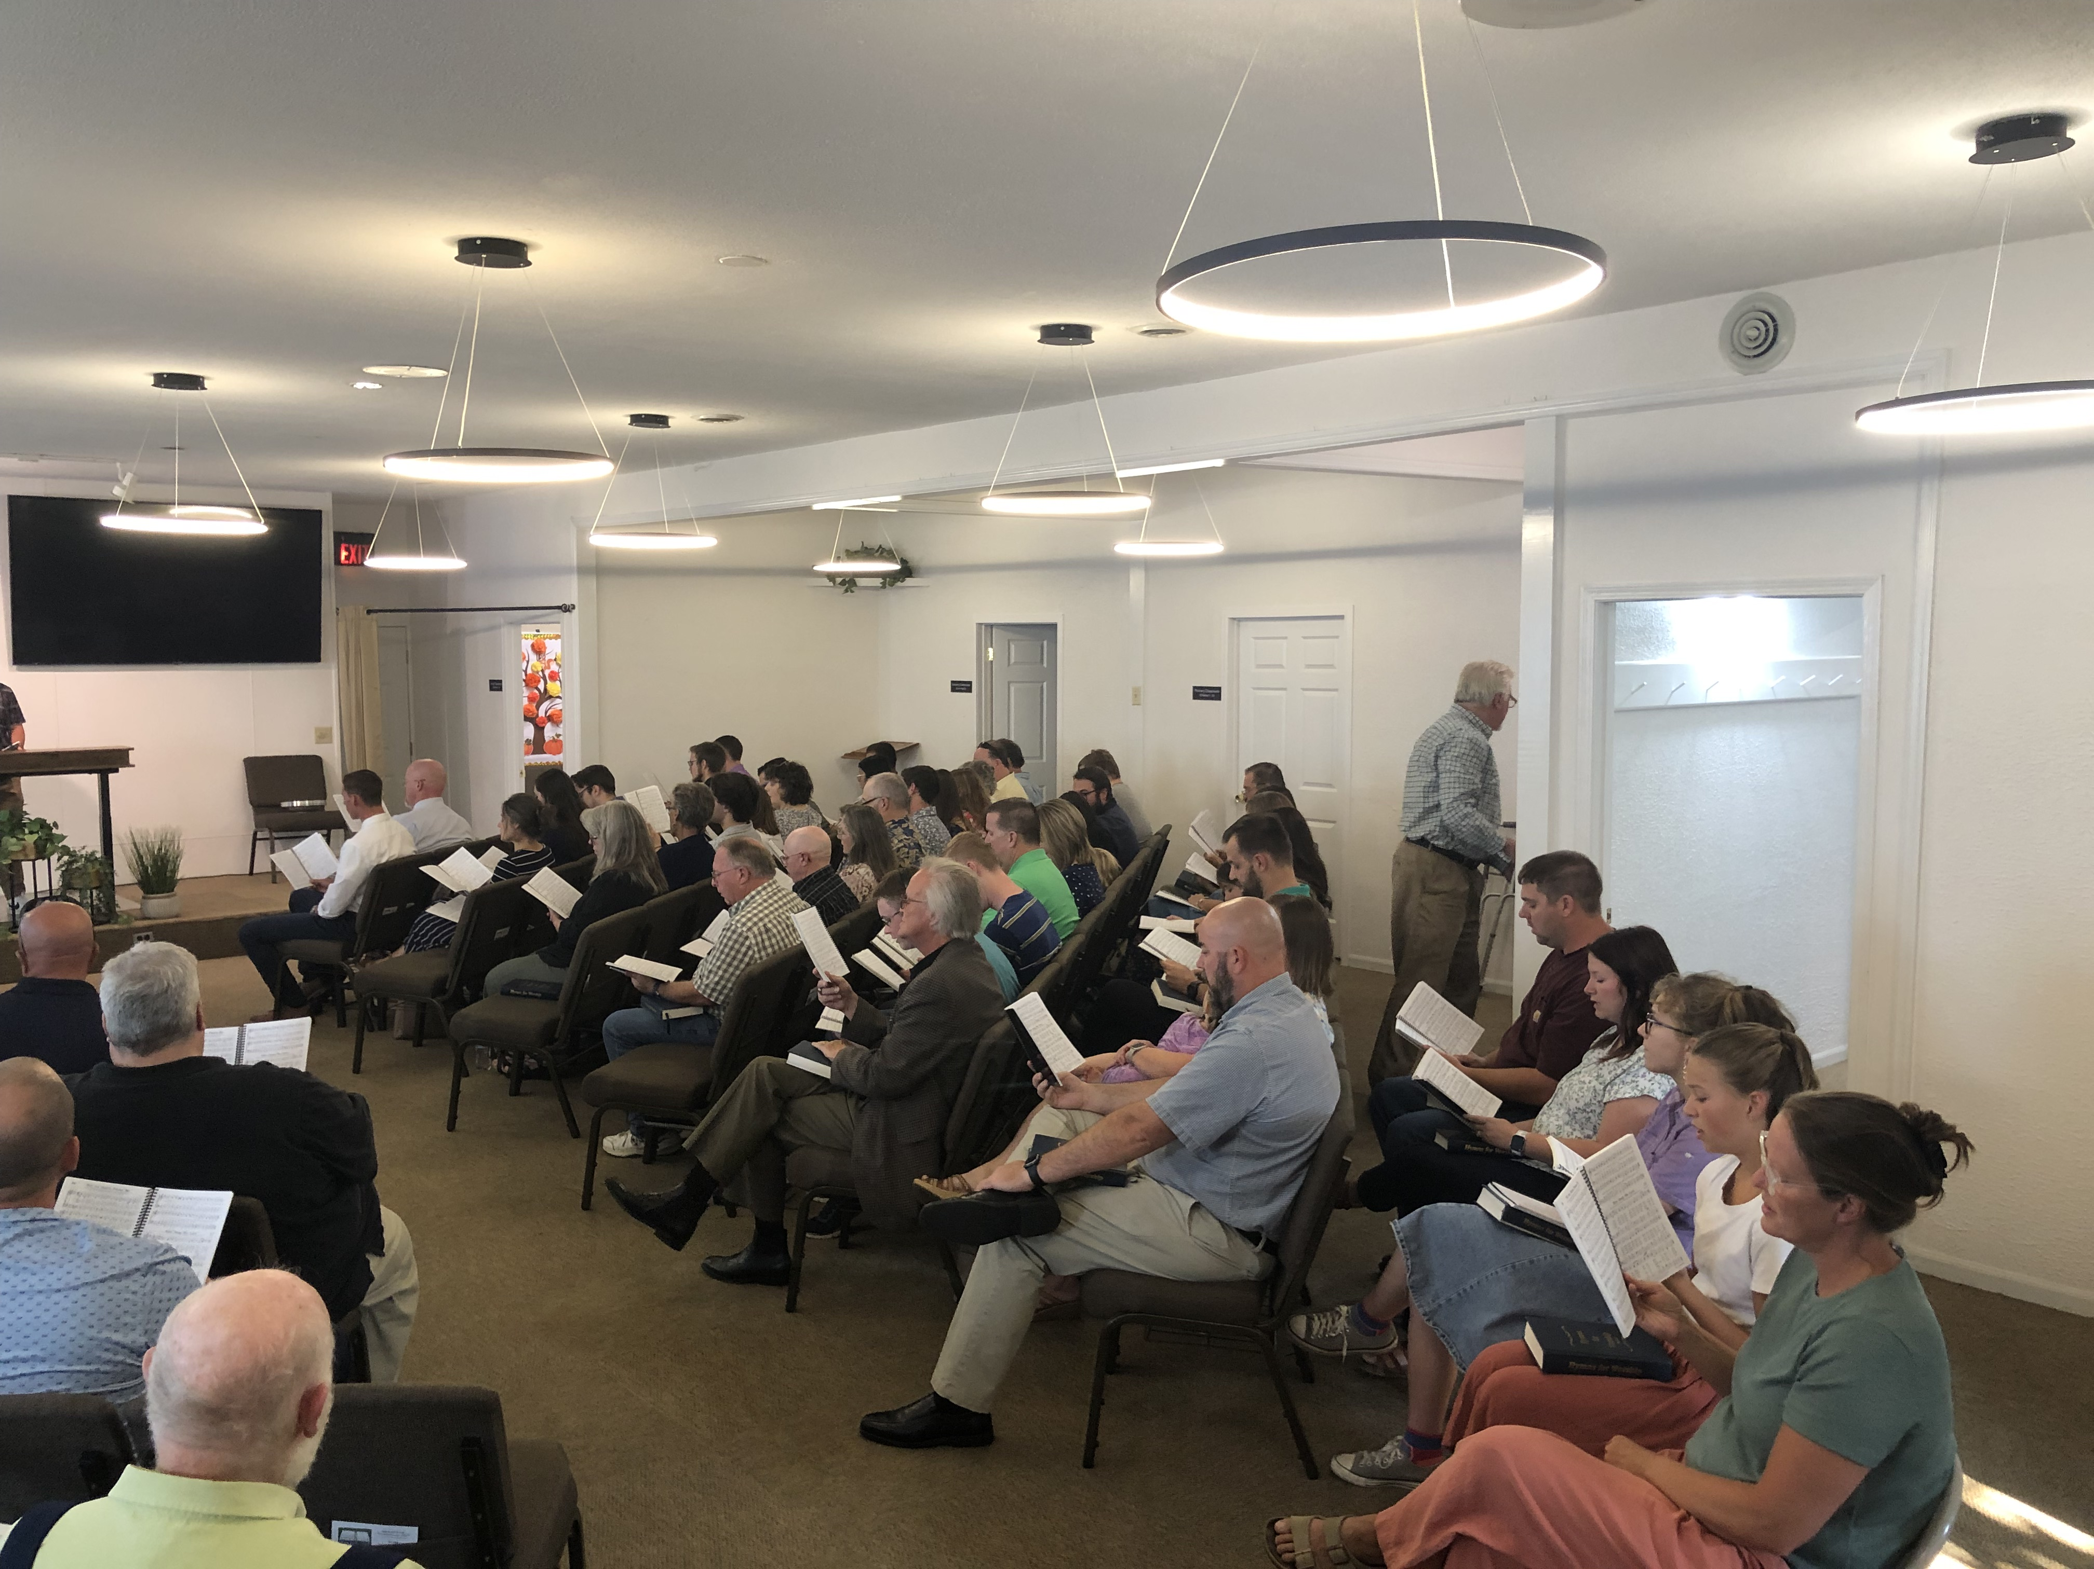
Winter and Summer Singings 2024
January 26th
88 people
July 26th
107 people
Singings since 2017

Slide 4
Future Singings
*We will have our Singing at the Building on January 24, 2025. Invite family, friends, and neighbors to the Singing!
Every 1st Wednesday

Slide 5
Importance of Singing Together
Ephesians 5:19-21
¹⁹ speaking to one another in psalms and hymns and spiritual songs, singing and making melody in your heart to the Lord, ²⁰ giving thanks always for all things to God the Father in the name of our Lord Jesus Christ, ²¹ submitting to one another in the fear of God.
Colossians 3:16-17
¹⁶ Let the word of Christ dwell in you richly in all wisdom, teaching and admonishing one another in psalms and hymns and spiritual songs, singing with grace in your hearts to the Lord. ¹⁷ And whatever you do in word or deed, do all in the name of the Lord Jesus, giving thanks to God the Father through Him.

Slide 6
Several Potlucks
If you’ve never hosted a potluck, I highly recommend it! It’s a great way to get to know one another
Acts 2:42
⁴² And they continued steadfastly in the apostles’ doctrine and fellowship, in the breaking of bread, and in prayers.

Slide 7
Many, Many Prayer Requests!
I Thessalonians 5:17
¹⁷ pray without ceasing,
Romans 1:9
⁹ For God is my witness, whom I serve with my spirit in the gospel of His Son, that without ceasing I make mention of you always in my prayers,

Slide 8
Many Flowers and Cards Were Sent Out
At the end of 2023 and throughout 2024: We lost Tracy Fulton, Lucille Benge, Stewart Hardy, Austin Popplewell, Marsha Hamilton, and Terry Baldwin
Romans 12:15
¹⁵ Rejoice with those who rejoice, and weep with those who weep.
*I would like to issue a challenge:
Find someone in the congregation that you may not know very well, invite them out to coffee, or over to your house for dinner

Slide 9
Gospel Meetings
March 29-31 Gospel Meeting by Joe Hardy
Joe has been working with the congregation in evangelism efforts and in preacher training
October 13-16 Gospel Meeting with Bob Quinn
2 Timothy 4:2
² Preach the word! Be ready in season and out of season. Convince, rebuke, exhort, with all longsuffering and teaching.

Slide 10
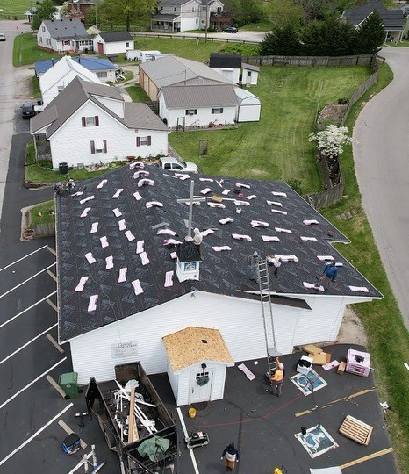
New Roof, Parking Lot Paved, HVAC Work
1 Peter 2:5
⁵ you also, as living stones, are being built up a spiritual house, a holy priesthood, to offer up spiritual sacrifices acceptable to God through Jesus Christ.
Haggai 1:3-11
Paneled houses!

Slide 11
Bible Classes and Bible Studies
Adult Bible Class: Gospel of Luke, Genesis
Teen Class: the Pentateuch and Joshua.
Younger kids’ classes: Abraham, the Creation, Adam & Eve,
Noah, Joseph, Moses, David, and the Fruits of the Spirit.
*If you have never signed up to teach before, considering signing up a for a Quarter in 2025.
There have also been Teen Studies, Young Adult Studies, and Ladies Studies
2 Timothy 2:15
¹⁵ Be diligent to present yourself approved to God, a worker who does not need to be ashamed, rightly dividing the word of truth.

Slide 12
We’ve Gained New Members
Evan Powell, Matt Green, Will Richardson, Bennett Patterson, Noah Encinas, Dan and Shirley Moody.
We even had someone come in off of the street and ask to be baptized: April 3, 2024 Omar Rodriguez
Acts 2:47
⁴⁷ praising God and having favor with all the people. And the Lord added to the church daily those who were being saved.
Romans 6:1-7 baptized into Christ, baptized into His death
We had 459 visitors in 2024 (avg. 38 per month).

Slide 13
Let’s Commit Ourselves
2 Peter 1:3-8 giving all diligence
Ephesians 4:13
¹³ till we all come to the unity of the faith and of the knowledge of the Son of God, to a perfect man, to the measure of the stature of the fullness of Christ;
Philippians 3:13-14
¹³ Brethren, I do not count myself to have apprehended; but one thing I do, forgetting those things which are behind and reaching forward to those things which are ahead, ¹⁴ I press toward the goal for the prize of the upward call of God in Christ Jesus.
The Central congregation began on May 6, 2001
This coming May will begin our 25th year as a congregation

